Slide 1
Workshop 2 Evaluation of leadership styles and strategies

Slide 2

You are here: …
CLIENT
CLARITY
CREATE
CHANGE
CONFIRM
CONTINUE
CLOSE
WORKSHOP 1:
Analyse client Needs
Organisational Strategy
WORKSHOP 2:
Leadership Styles
Culture, values, legal, ethical environment
WORKSHOP 3:
Creative Thinking
WORKSHOP 4:
Managers as Effective Leaders
Communication Tools
WORKSHOP 1: Key Concepts
The role of the consultant
Assessing clients’ needs
Strategic position
Performance management
WORKSHOP 2: Key concepts
Leaders vs Managers
Transformational, transactional and situational leadership styles
impact on organisational strategy
Creation of the organisation’s vision, mission and values
Influence of legal, ethical and social values on leadership
WORKSHOP 3: Key Concepts
Tools and techniques for creative thinking;
Brainstorming
Six thinking hats
Managing Uncertainty
Reflective practice
WORKSHOP 4: Key concepts
Good and poor Communication examples
Ways of communication - VARK
Communication with Stakeholders
Learning Journey 1 –Preparation Material for Workshop 1:
Role of the consultant
The 7 Cs of consulting
Strategy
Learning journey 2 - End of Workshop 1 Information and Preparation Material for Workshop 2:
STRATEGY
What is strategy?
Strategic positioning
Tools & techniques for assessing client needs
Benchmarking
Performance management
Preparation for workshop 2
Learning journey 3 - End of Workshop 2 Information and Preparation Material for Workshop 3:
LEADERSHIP
Understanding management & leadership styles
Leadership videos
Leading for an unpredictable future
Preparation for workshop 3
Learning journey 4 - End of Workshop 3 Information and Preparation Material for Workshop 4:
LEADERS AS CHANGE AGENTS
The 7 Cs of consulting
Linking theory and practice
How to get out of the box video
Creativity & leadership
Preparation for workshop 4
Learning journey 5 - End of Workshop 4 Information
COMMUNICATION & CONSOLIDATION
Communication checklist
Communicating across cultures
Good communication tools and tips
Assessment guidance

Slide 3
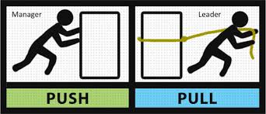
Some questions from the Learning Journey…
Have you looked at the news report about Gareth Southgate? [Video]
Do you consider him to be a leader?
Or a manager?
What’s the difference?

Slide 4
Category | Leadership | Management
Thinking process | Focuses on people Looks outwards | Focuses on things Looks inwards
Goal Setting | Articulates a vision Creates the future Sees the forest | Executes plans Sees the present Sees the trees
Employee Relations | Empowers colleagues Trusts and Develops | Controls Subordinates Directs and coordinates
Operation | Does the right things Creates changes Serves subordinates | Does things right Manages changes Serves superordinates
Governance | Uses influence Uses Conflict Acts Decisively | Uses authority Avoids conflict Acts responsibly
(Lunenburg 2011)

Slide 5
Workshop 2 Overview
Learning outcomes for workshop 2
Activity 1 – Video and Quiz
Activity 2 – Group Presentation
Activity 3 - Debate
Activity 4 – Leadership strategies
Assessment Exercise
Review of Learning Outcomes
Action points

Slide 6
Learning Outcomes For Workshop 2
By the end of this workshop, and by studying the associated Learning Journey materials, you will be able to:
Evaluate the relationship between strategic management, leadership and leadership styles and principles that support organisational ethical and value-based approaches to leadership
Evaluate the application of leadership strategies and the impact on organisational direction

Slide 7
Activity 1 Video and Quiz

Slide 8
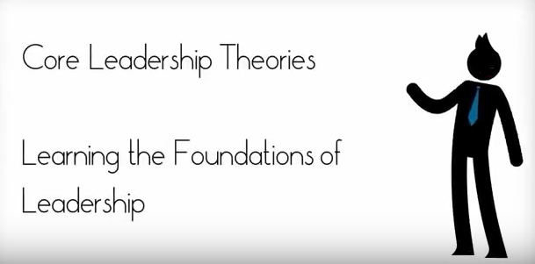
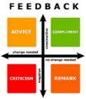
Activity 1 – Video
Video :- Core Leadership Theories
Video :- Ten Leadership Theories in Five Minutes

Slide 9
Summary of leadership theories
Trait Theories
Behaviourist Theories
Contingency Theory
Power and influence Theory
(further reading: Alimo-Metcalfe 2013; Dugan 2017)

Slide 10
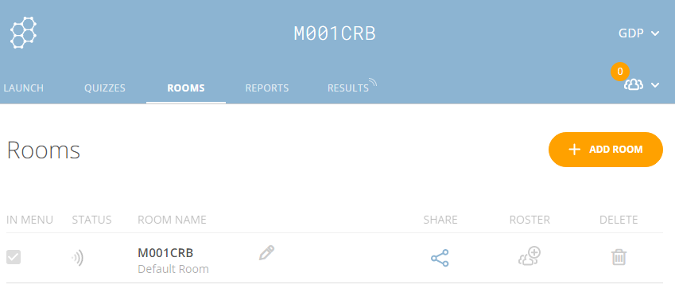
Activity 1 – Quiz
http://www.socrative.com/
Mobile Phone Set Up for SOCRATIVE – Room Number - M001CRB

Slide 11
Activity 2 Group Presentation

Slide 12
Activity 2 – Group Presentation
Discuss types of leadership or leaders you are familiar with.
Draw on your own experiences and refer to one or more continents.
In your discussions consider:
Leadership styles
Examples of cases where leaders have had strategic impact on an organisation’s mission or vision
How legal, ethical and social values have influenced leadership.
Time allowed
15 minutes group preparation
3 minutes feedback per group

Slide 13

Present your group findings

Slide 14
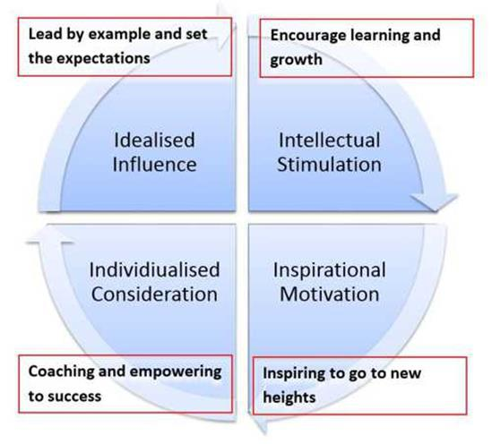
Four I’s of transformational leadership
These Four I’s of transformational leadership describe the four common behaviours of transformational leaders
See the leadership direct link
(Bass and Avolio 1994; Bass and Mahwah 2006)
Notes:
Leadership direct link: http://mde.managers.org.uk/coventry/content.aspx?lj=false&id=84632

Slide 15

Break

Slide 16
Activity 3 Group Debate

Slide 17

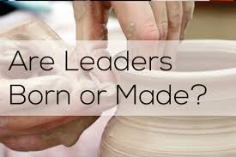
Activity 3 – Debate
Time allowed:
10 minutes’ preparation
20 minutes’ debate
Develop and present an argument either for or against the following:
‘Leaders are born not made’
‘Leaders should adopt one consistent style’

Slide 18

Debate
5 minute (maximum) per team to include:
1 minute (maximum) opening statement from each side.
Facilitator invites statements from each side in turn (agreeing, opposing, agreeing, opposing etc.)
1 minutes summing from each side before the vote.
Those not involved in the debate vote.

Slide 19

Debate

Slide 20
Activity 4 Leaders and Followers

Slide 21
Activity 4 - Leaders and followers
Video - How to start a movement
Reflection: Can you think of examples from your own life where you have been a leader and/or a follower?
What strategies may be beneficial to effective leadership? What strategies did Gareth Southgate employ as a leader?
Notes:
Southgate strategies discussed on the video: created a team mentality, discouraged individual egos, led by example, uses plain language (rather than jargon), unafraid to take risks.

Slide 22
Leadership strategies
Adaptability
Change management
Provide followers with developmental opportunities
Communicate a vision
Encourage team recognition
Delegate effectively
Think holistically
Listen to others
And more . . . .
(Boal and Hooijberg 2000; Crossman, Vera, and Nanjad 2008; Parry 1999)

Slide 23
Activity 5 Assignment Feedforward

Slide 24
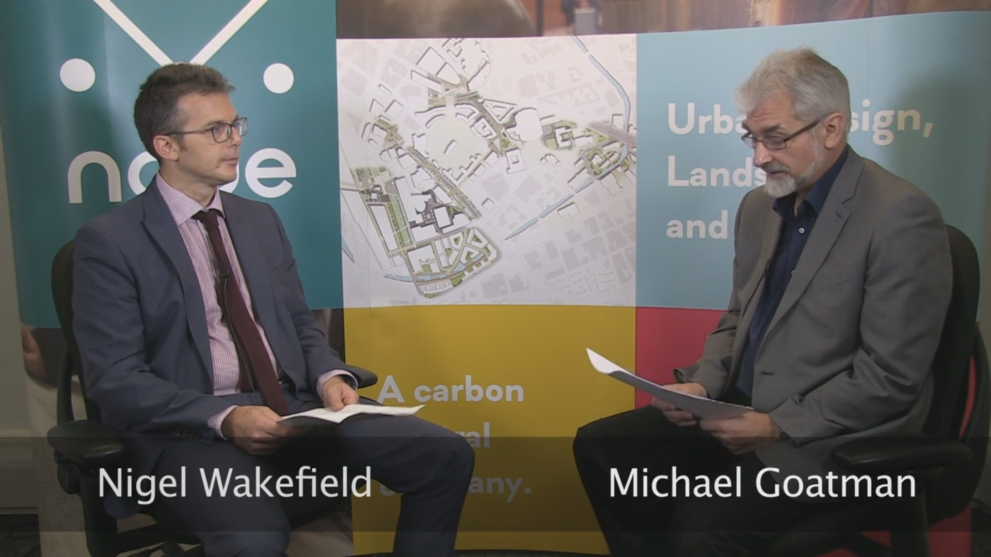
Leadership – Employer Scenario
Watch the video for NODE Urban Design Limited
From 02:30 -4:00
Form a group of about 5 students
Discuss the questions in relation to NODE
Respond to the questions on the next slide
https://media.coventry.ac.uk/Login.aspx?returnUrl=%2FPlay%2F19545

Slide 25
Leadership – Employer Scenario
Identify the current leadership style of NODE Urban Design Limited
What leadership style would you as a group recommend to NODE Urban Design Limited?
Ideas will be presented to the rest of the class for review.
Time allowed:
10 minutes’ preparation
2 minutes’ feedback per group

Slide 26
Review of learning outcomes from workshop 2

Slide 27
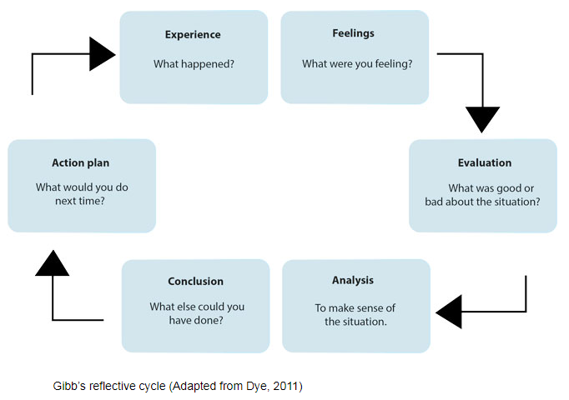
Review Of Learning Outcomes
1. Each one of you should reflect (using Gibb’s RC) and write down two keys things they have learnt in this session.
2. Also, write down how he/she would apply the two key learning outcomes to your selected assignment task
Time allowed:
5 minutes preparation time
2 minutes feedback from a few students

Slide 28

Next Step
Today’s workshop has introduced a number of key leadership concepts
You must follow these up by going through the materials in learning journey 3
You should attempt to apply the knowledge to your selected assignment task

Slide 29
Next Step
Complete the online learning journeys
View the employer scenarios
Choose one scenario to focus on for your assessment

Slide 30
Learning Journey

Slide 31
You are here ...…
CLIENT
CLARITY
CREATE
CHANGE
CONFIRM
CONTINUE
CLOSE
WORKSHOP 1:
Analyse client Needs
Organisational Strategy
WORKSHOP 2:
Leadership Styles
Culture, values, legal, ethical environment
WORKSHOP 3:
Creative Thinking
WORKSHOP 4:
Managers as Effective Leaders
Communication Tools
WORKSHOP 1: Key Concepts
The role of the consultant
Assessing clients’ needs
Strategic position
Performance management
WORKSHOP 2: Key concepts
Leaders vs Managers
Transformational, transactional and situational leadership styles
impact on organisational strategy
Creation of the organisation’s vision, mission and values
Influence of legal, ethical and social values on leadership
WORKSHOP 3: Key Concepts
Tools and techniques for creative thinking;
Brainstorming
Six thinking hats
Managing Uncertainty
Reflective practice
WORKSHOP 4: Key concepts
Good and poor Communication examples
Ways of communication - VARK
Communication with Stakeholders
Learning Journey 1 –Preparation Material for Workshop 1:
Role of the consultant
The 7 Cs of consulting
Strategy
Learning journey 2 - End of Workshop 1 Information and Preparation Material for Workshop 2:
STRATEGY
What is strategy?
Strategic positioning
Tools & techniques for assessing client needs
Benchmarking
Performance management
Preparation for workshop 2
Learning journey 3 - End of Workshop 2 Information and Preparation Material for Workshop 3:
LEADERSHIP
Understanding management & leadership styles
Leadership videos
Leading for an unpredictable future
Preparation for workshop 3
Learning journey 4 - End of Workshop 3 Information and Preparation Material for Workshop 4:
LEADERS AS CHANGE AGENTS
The 7 Cs of consulting
Linking theory and practice
How to get out of the box video
Creativity & leadership
Preparation for workshop 4
Learning journey 5 - End of Workshop 4 Information
COMMUNICATION & CONSOLIDATION
Communication checklist
Communicating across cultures
Good communication tools and tips
Assessment guidance

Slide 32



Slide 33
References
Alimo-Metcalfe, B. (2013) A critical review of leadership theory, in eds. Leonard, H., Lewis, R., Freedman, A., Passmore, J. The Wiley‐Blackwell Handbook of the Psychology of Leadership, Change, and Organizational Development, London: John Wiley & Sons
Bass, B. and Avolio, B. (1994) Improving organizational effectiveness through transformational leadership, London: Sage
Bass, B. and Mahwah, R. eds (2006) Transformational leadership, 2nd ed., Bernard M Bass and Ronald E Riggio Mahwah NJ
Boal, K. and Hooijberg, R. (2000) Strategic Leadership Research: moving on, Leadership Quarterly, 11(4), 515–549
Crossman, M., Vera, D. and Nanjad, L. (2008) Transcendent leadership: Strategic leadership in dynamic environments. Leadership Quarterly 19, 569–581
Dugan, J. (2017) Leadership Theory: cultivating critical perspectives, San Francisco, CA: Jossey-Bass
Lunenburg, F.C. (2011). ‘Leadership versus management: A key distinction – at least in theory.’ International Journal of Management, Business and Administration, Volume 14 (1)
Ken W. Parry, (1999) "Enhancing adaptability: leadership strategies to accommodate change in local government settings", Journal of Organizational Change Management, Vol. 12 Issue: 2, pp.134-157

